Slide 1
Analysis of Mental Health- Depression
Debobrat | Swetha | Riddhi | Vamsi | Mithil
Categories:
Data Science and Visualization
Best beginner hack
Healthcare
Community

Slide 2



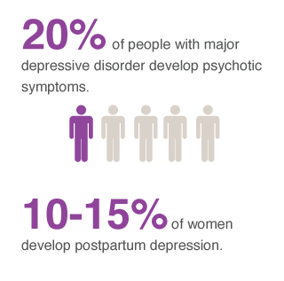

Statistics
Impact
1 in 5 adults in America experience mental illness
Notes:
Source: http://www.phrma.org/mental-health-medicines-in-development-report-2014
https://www.nami.org/NAMI/media/NAMI-Media/Infographics/GeneralMHFacts.pdf

Slide 3
Previous Research
Identifying the depression
Intensity of depression
Originality
Depression level
Cause of depression
Network and interaction of the users – Network Analytics

Slide 4





High level overview
Technologies Used
Technologies used
Data Collection
Data Cleaning
Preliminary research and analysis
Algorithm to identify depression and cause
Analyze data and visualize

Slide 5
Data Collection
Researched depression related keywords
Collected latest tweets containing these keywords
Identified these users(twitter handles) as possible depressed users
Collected recent 200 tweets for each user

Slide 6
Data Cleaning
Created list of unique users by eliminating duplicates
Ignored tweets in other languages
Removed special characters from the tweets

Slide 7
Preliminary research and analysis
Researched about the causes of depression.
Researched the keywords to identify causes of depression

Slide 8
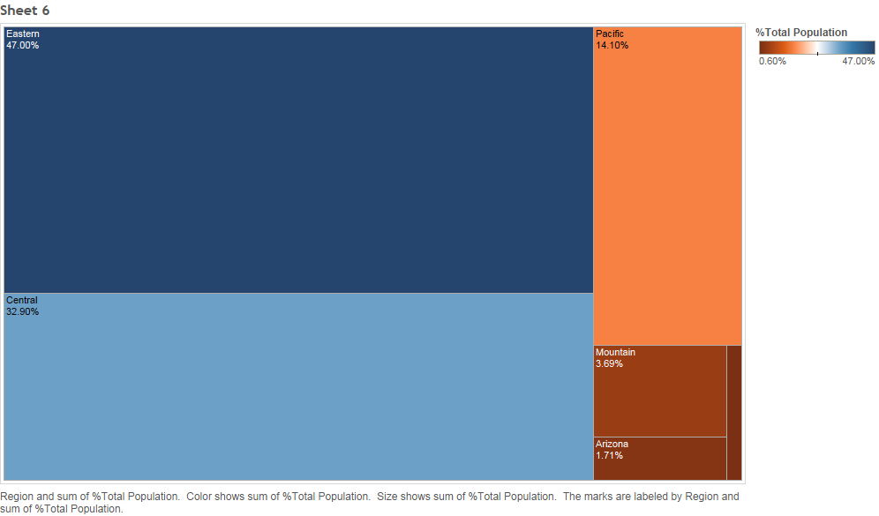
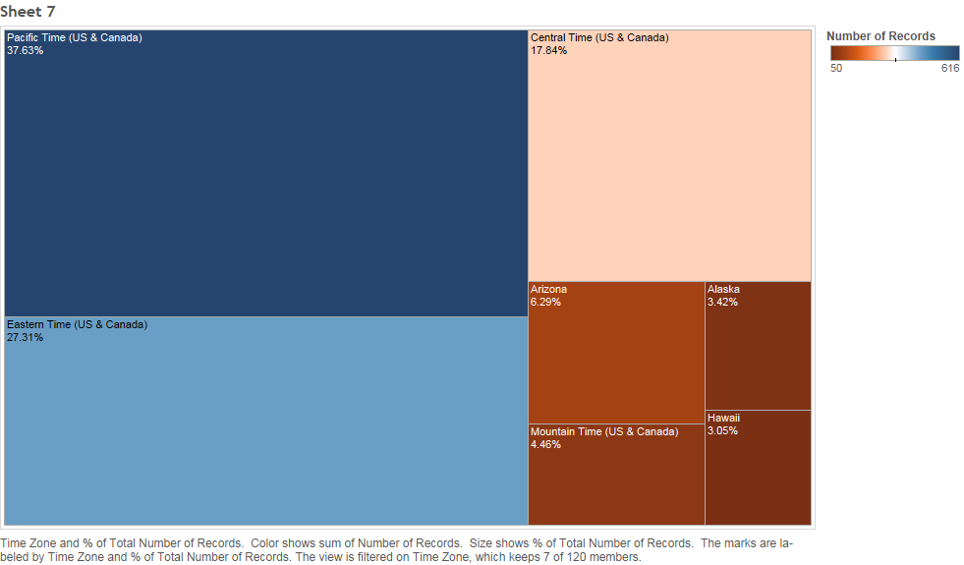
Preliminary analysis

Slide 9
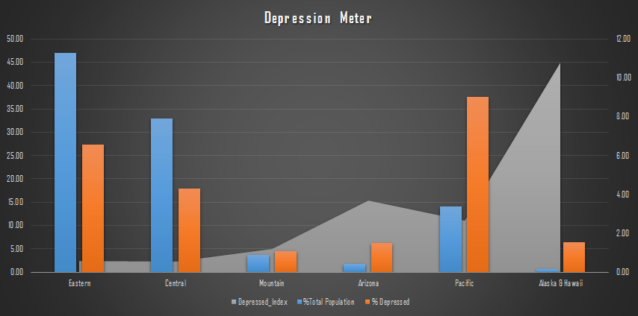
Preliminary analysis

Slide 10
Algorithm to identify depression and cause
Wanted to identify what these users are primarily concerned about what topic
Did NLP to identify sentiment of their latest tweets and determined polarity
Categorized negative tweets based on polarity as: Anxiety, Depressed etc…
Analyzed the contents of user’s latest tweets to identify cause of negative sentiment
Gave score for the 3 broadly classified causes of depression
Analyzed prominent cause of depression
Network analysis
Analyzed connections between the users who are showed symptoms of depression
Identified the users who are most influential/connected in the network.

Slide 11
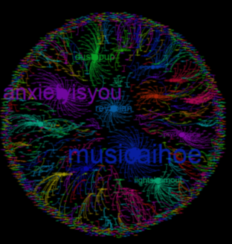
Analyze data and visualize
This network shows:
Most of the users are isolated (which is obvious)
Very few connected groups can be identified
These users who are mostly connected can be focus areas for businesses

Slide 12
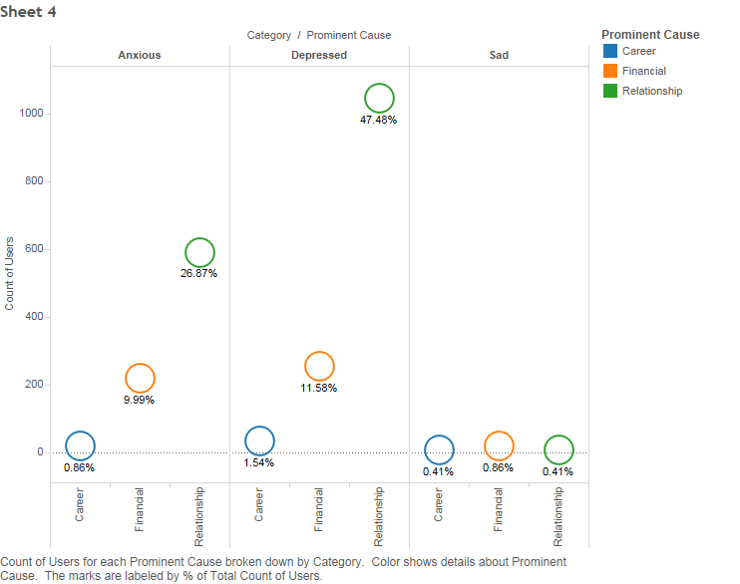
Analyze data and visualize

Slide 13
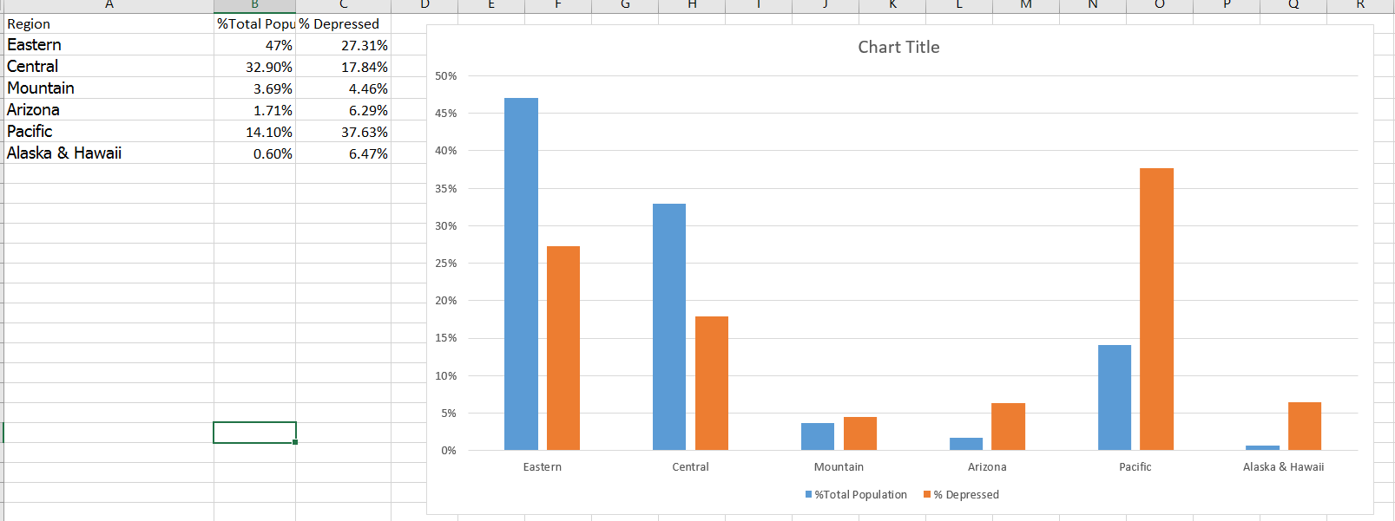
Analyze data and visualize

Slide 14
Business Use
Can be used by governments to help people having mental problems
Eliminates the old process of survey
Time and money saving
Can focus on cause of depression and so can be treated with personalized care
Can be used by re-hab to target ads or promotional graphics to these users

Slide 15
Future scope
Can use Twitter streaming API to get real time results
Develop a dictionary related to depression
Develop an APP for ease of use

Slide 16


